Slide 1

ClicktoHuddle
Training

Slide 2
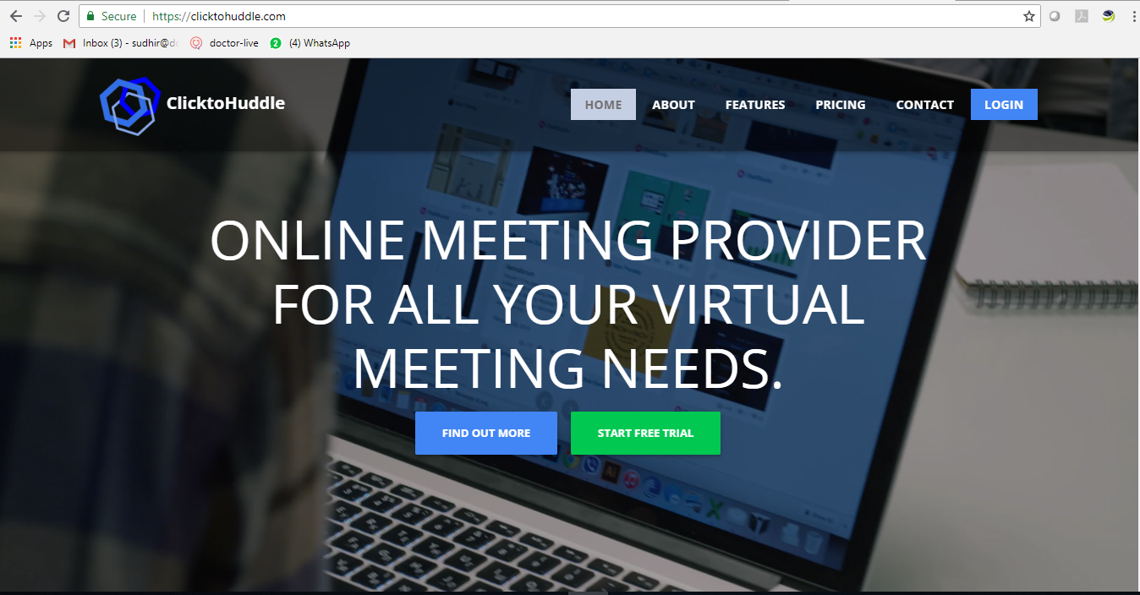
Visit www.clicktohuddle.com and familiarize with the portal
Click on Start Free Trial to register for the service
Slide 2 of 30 ClicktoHuddle Confidential

Slide 3
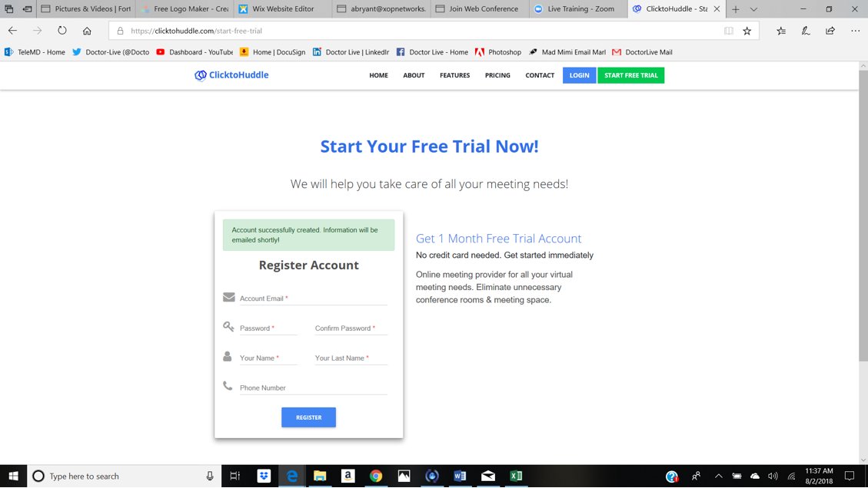
Register for your Free Trial
Enter Info
Register your Account
Fill out the information requested
Slide 3 of 30 ClicktoHuddle Confidential

Slide 4
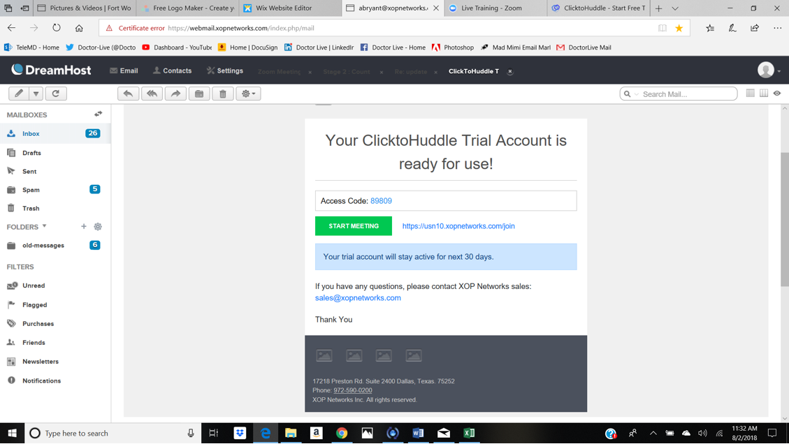
Welcome Email
Once the account is ready a welcome email will be sent to your email address
Make a note of the Access Code provided in the email
Click on Start Meeting
Slide 4 of 30 ClicktoHuddle Confidential

Slide 5
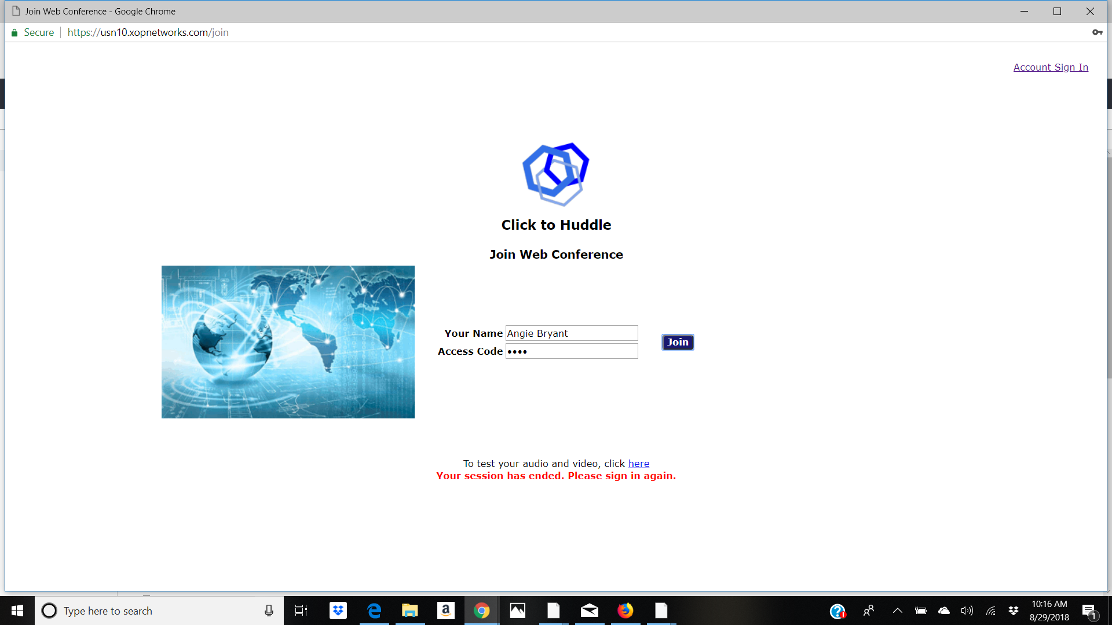
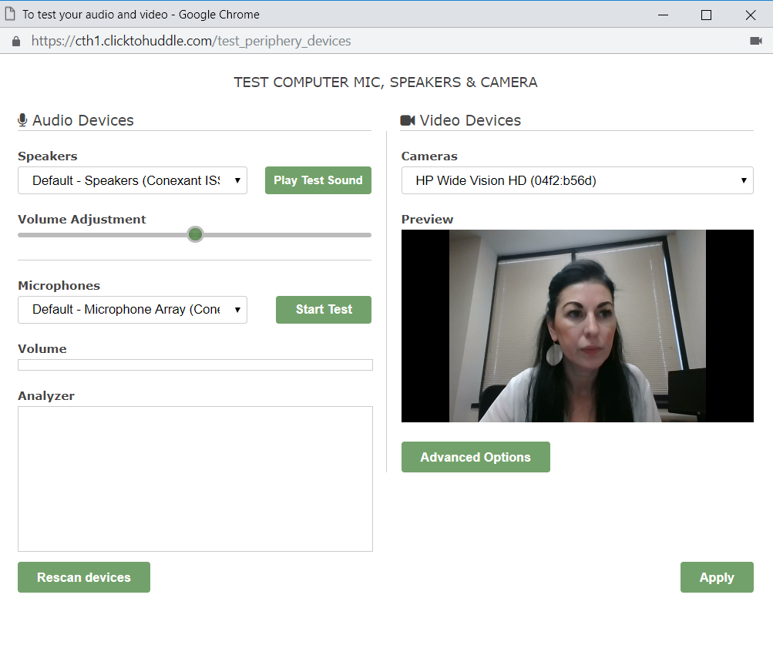
Test Your Audio & Video Before You Enter Your Huddle Room
Test Your Equipment
Click the link to test your equipment
Allow access to your PC’s microphone and webcam to your browser
Rescan equipment if you need to
Click apply
Slide 5 of 30 ClicktoHuddle Confidential

Slide 6
Entering Your Huddle Room
Enter Info
You can now enter the Huddle room
Enter your Name
Enter the assigned Access Code
Slide 6 of 30 ClicktoHuddle Confidential

Slide 7
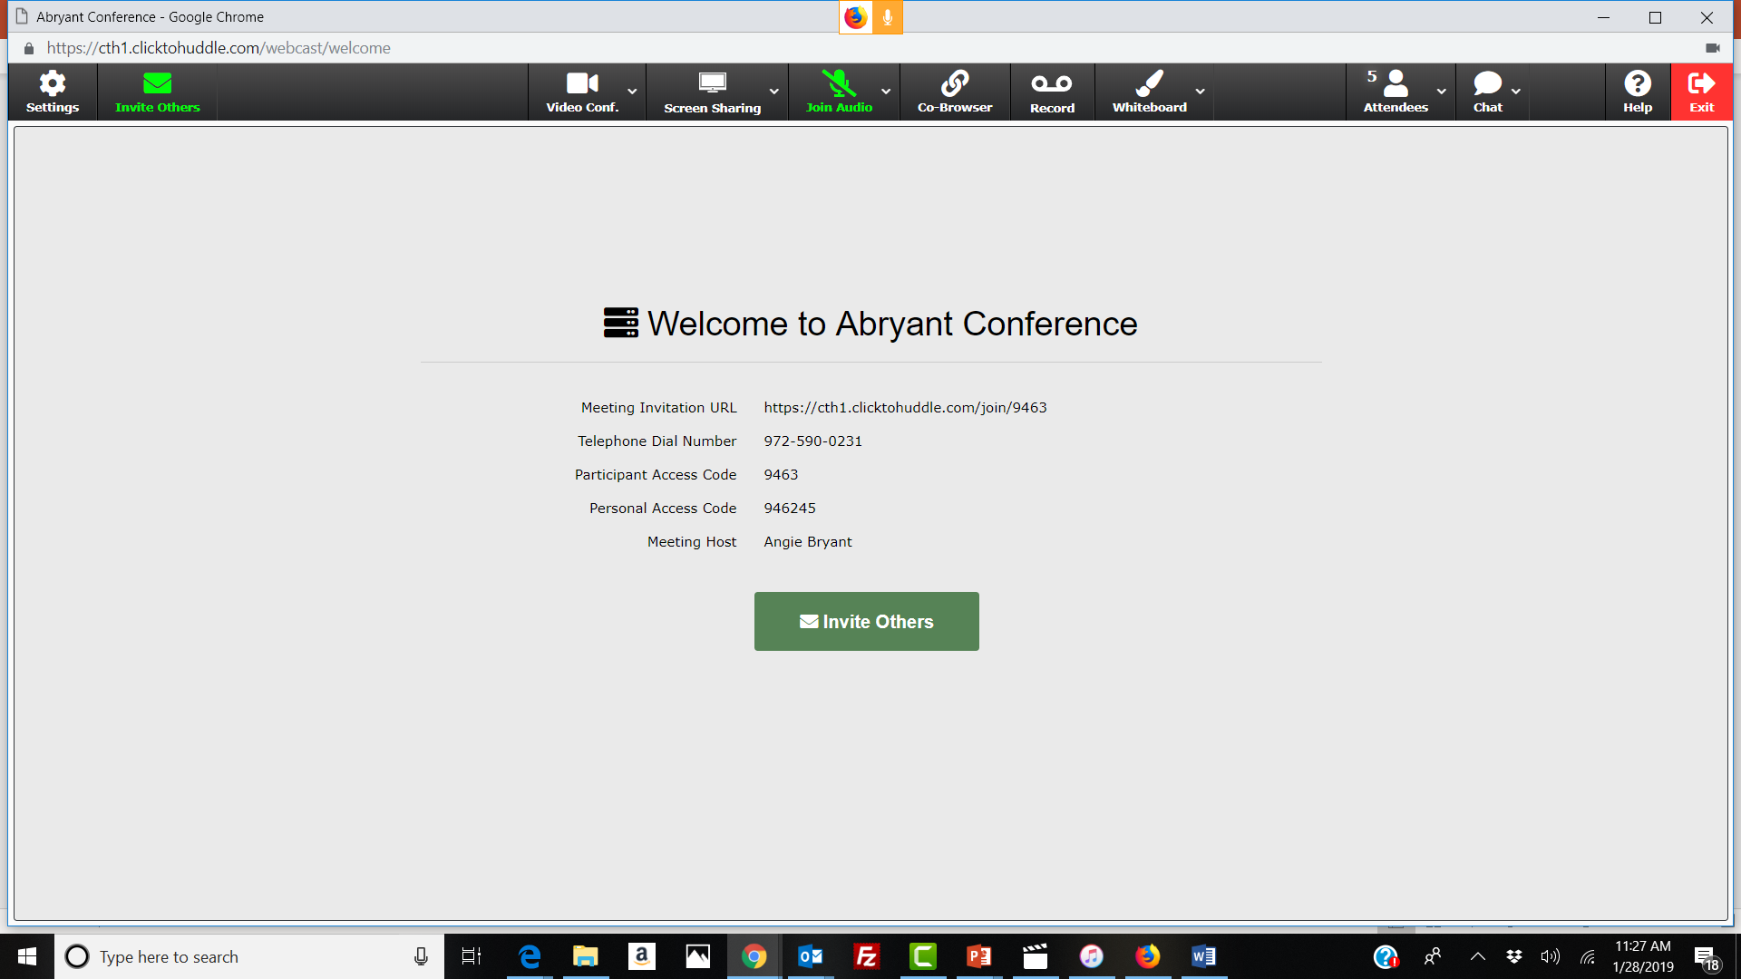
Start Your Huddle
Welcome to your Conference!
Click on Invite Others to send email invitations to fellow attendees.
Slide 7 of 30 ClicktoHuddle Confidential

Slide 8
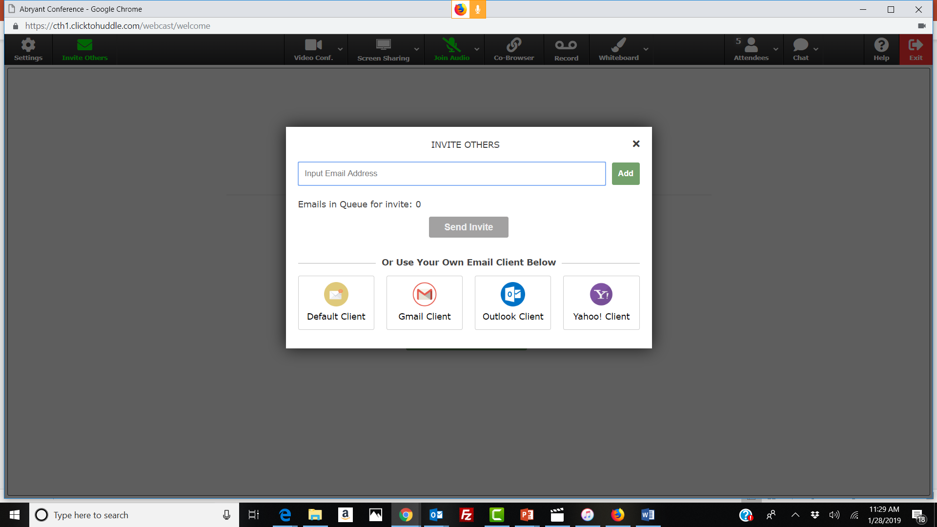
Inviting Others
After you clicked on Invite Others
Enter your attendees email addresses to invite them directly from the conference
Click Add after each email entry
Click send invite and they will be invited via email with a direct link to join your conference.
Slide 8 of 30 ClicktoHuddle Confidential

Slide 9
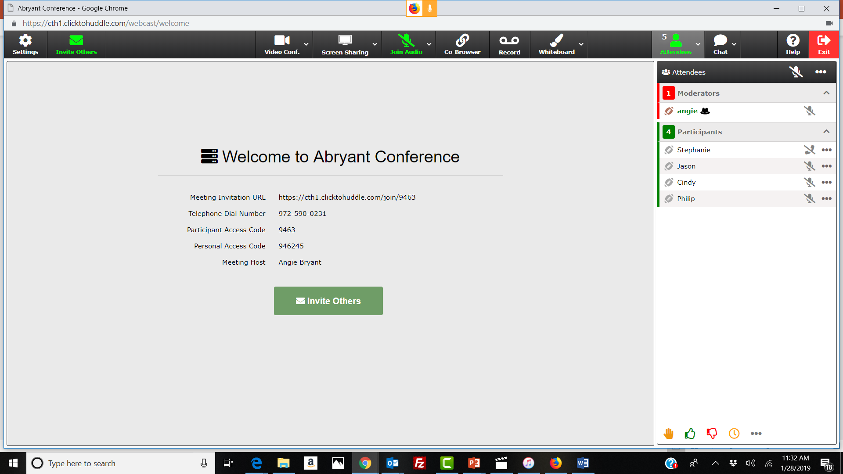
View Attendees
To view attendees in the conference click on the Attendees icon
Attendee panel will be displayed as shown
  Moderator is shown in the top section under moderators with a black hat indicating moderator
  Attendee with the brown football is currently the Presenter in the conference
The Moderator can pass the football to who ever wants to share their screen and can take back possession of the conference at any time
Slide 9 of 30 ClicktoHuddle Confidential

Slide 10
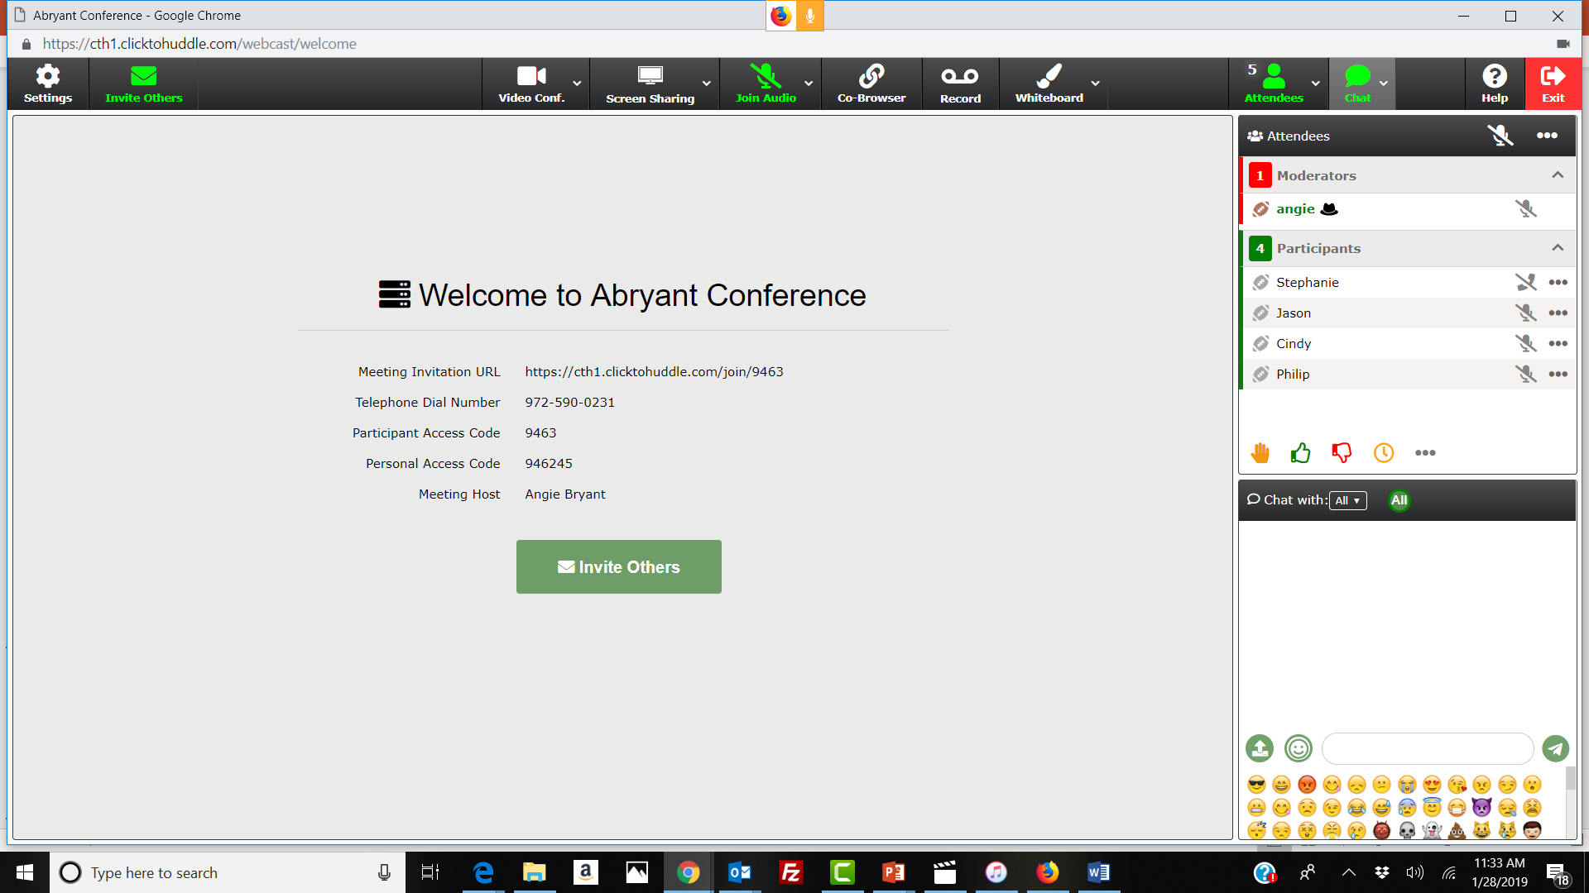
Chat Function
To chat with attendees in the conference click on the chat icon & it will populate on the far right
You can chat with all attendees
You can also have a private chat with a specific attendee
Attendees can upload and download documents via the chat panel.
Attendees can use emojis to express their emotions via chat
Slide 10 of 30 ClicktoHuddle Confidential

Slide 11

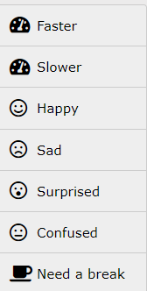
Interactive Feedback Functions
Attendees can interact with many emotes – raise hand for a question, vote on a topic or make a quick comment
Click on the attendee panel
Click on relevant emote
Additional emotes can be found by clicking on the three dots
Slide 11 of 30 ClicktoHuddle Confidential

Slide 12
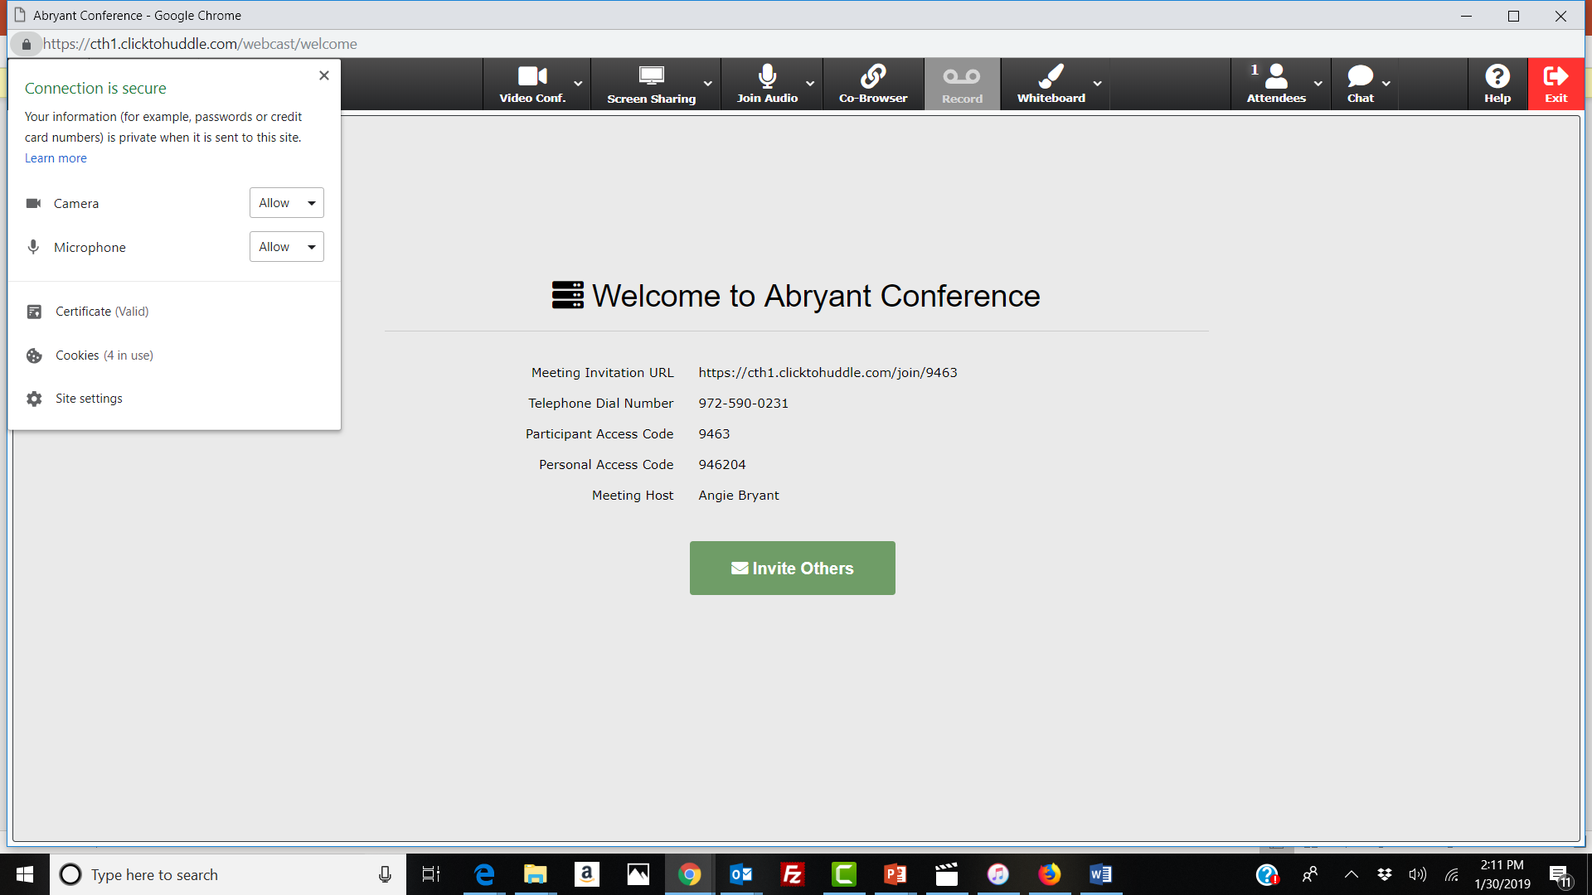
Ensure Your Audio & Video Settings Are Enabled
Before you start sharing Audio or Video capabilities, make sure your browser can access your PC’s microphone and webcam
Click on the lock icon on the left side of the URL (as seen on Chrome browser)
Ensure that Camera & Microphone are enabled
Slide 12 of 30 ClicktoHuddle Confidential

Slide 13

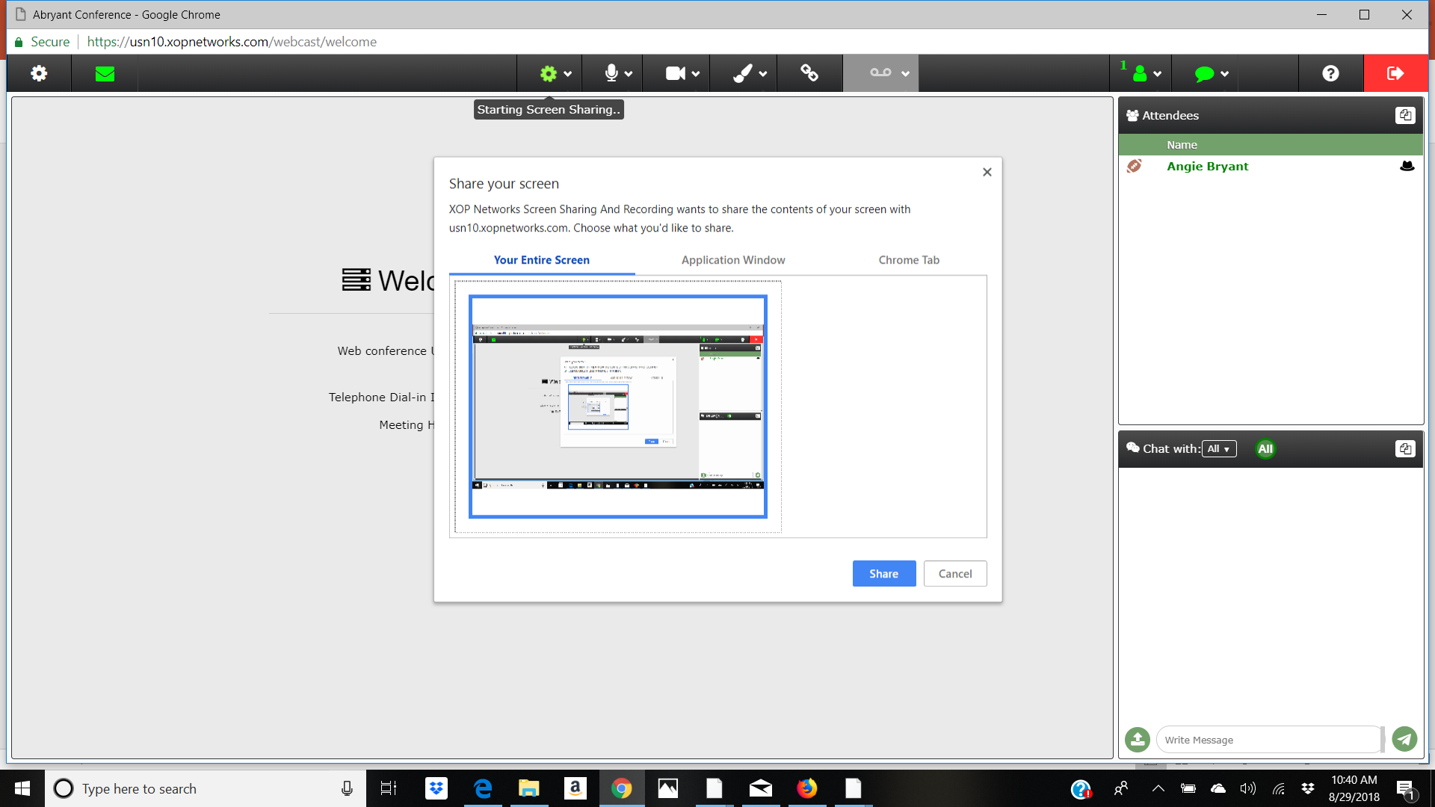
Start Screenshare
To start screenshare click the screen share icon, only the person in possession of the ball can share their screen
You will receive a pop up letting you choose to share your entire screen, specific application or a browser tab
In order to share your screen, you will need to add the XOP Chrome extension, see next page for directions
Slide 13 of 30 ClicktoHuddle Confidential

Slide 14
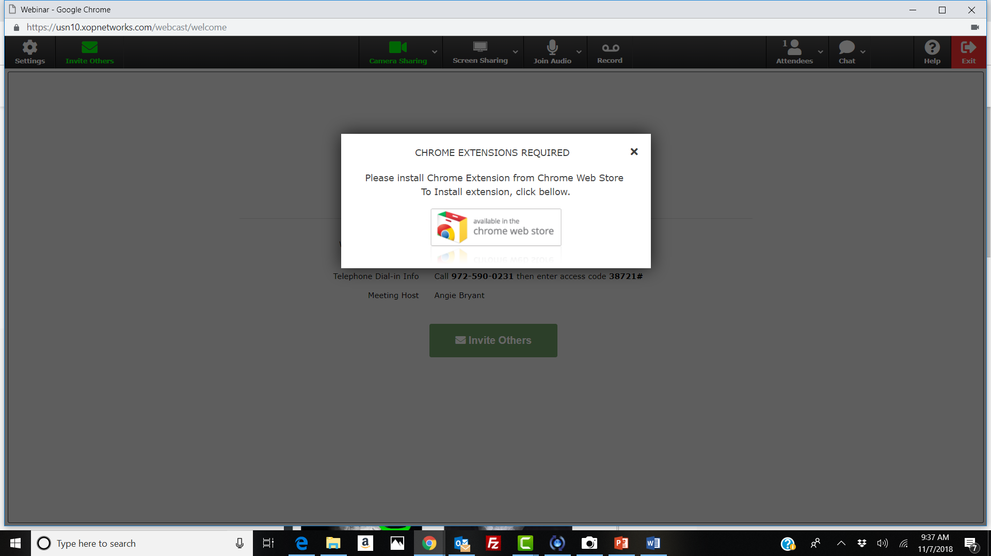
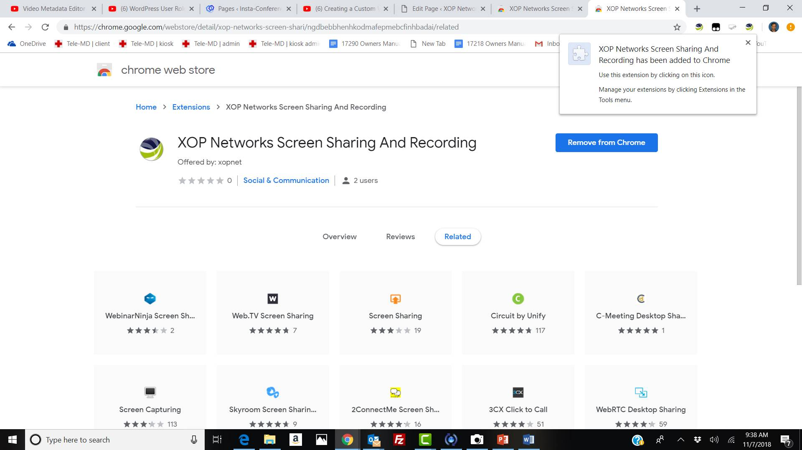
Adding Chrome Extension for Screensharing
To add the XOP Chrome extension, click on the link to the web store
In the web store, add the extension
After you install the Chrome extension, you will receive a pop up letting you choose to share your entire screen, specific application or a browser tab
Slide 14 of 30 ClicktoHuddle Confidential

Slide 15

Joining the Audio Conference
You can join the Audio Conference in two ways
1) Click on the Microphone icon to make a VoIP call. This option should be used preferably with a headset.
2) Dial the PSTN number displayed and enter the Personal access code
  As a Moderator you can Mute All attendees or Mute individual attendees
  Hold, Remove or Change Name of an Attendee
Slide 15 of 30 ClicktoHuddle Confidential

Slide 16
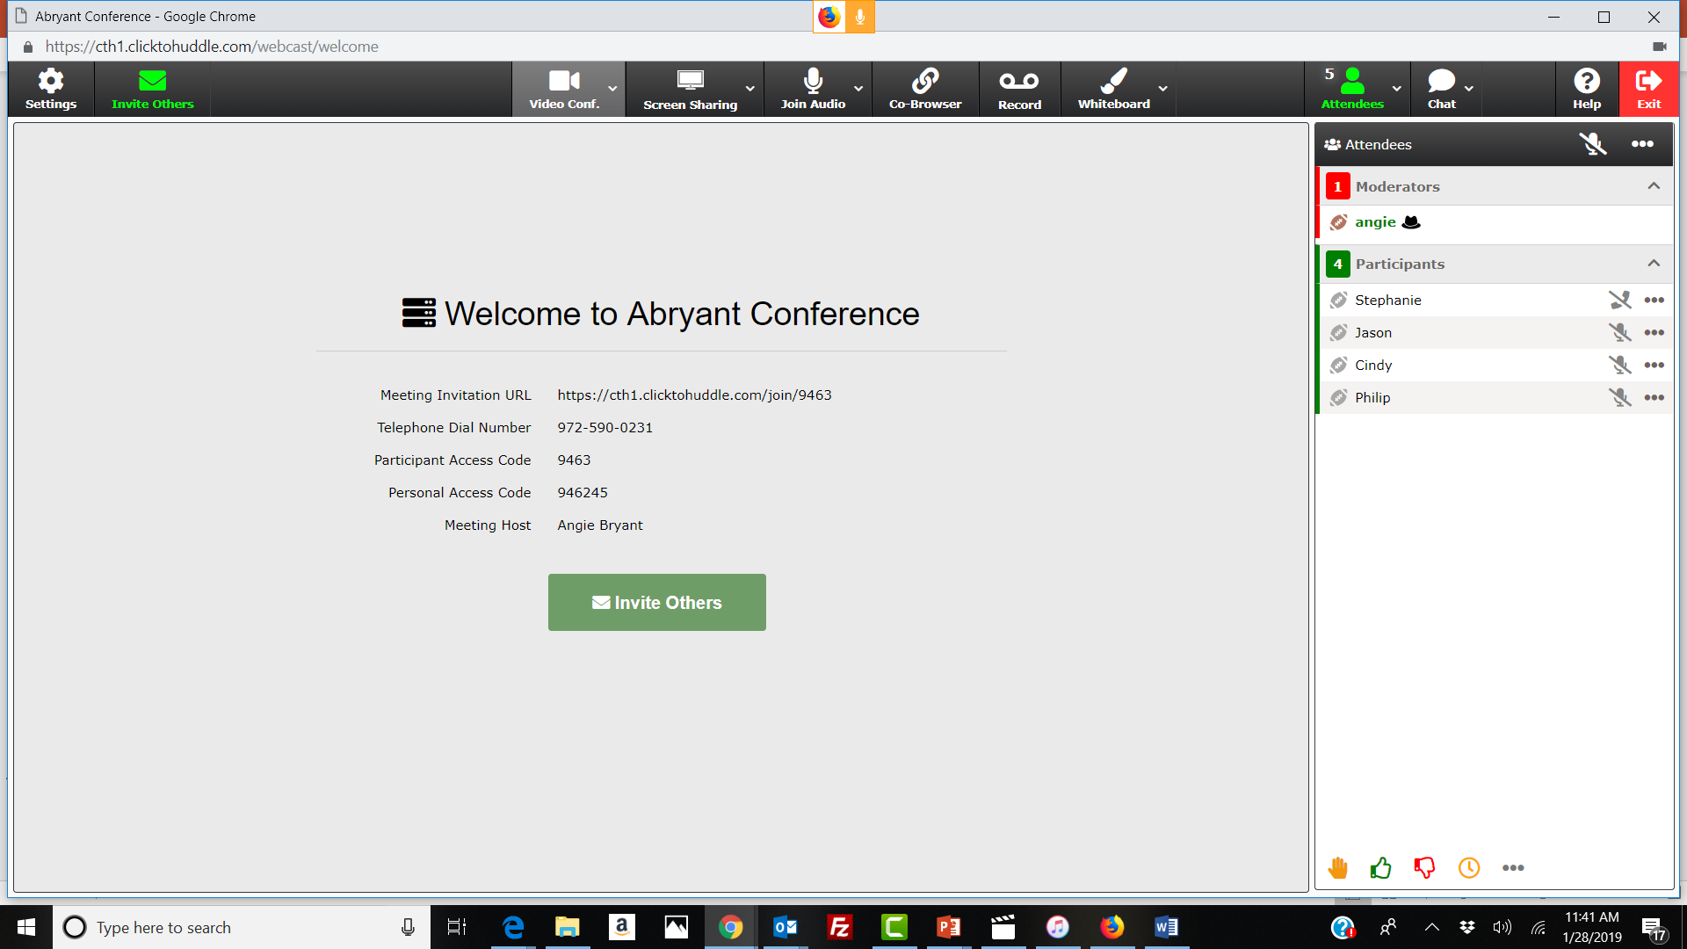
Start Video Conference
To start your video conference click on the camera icon
Ensure your camera access in enabled
Your video will be displayed on your screen. Other attendees will see your video in the video headshots displayed on top
Slide 16 of 30 ClicktoHuddle Confidential

Slide 17
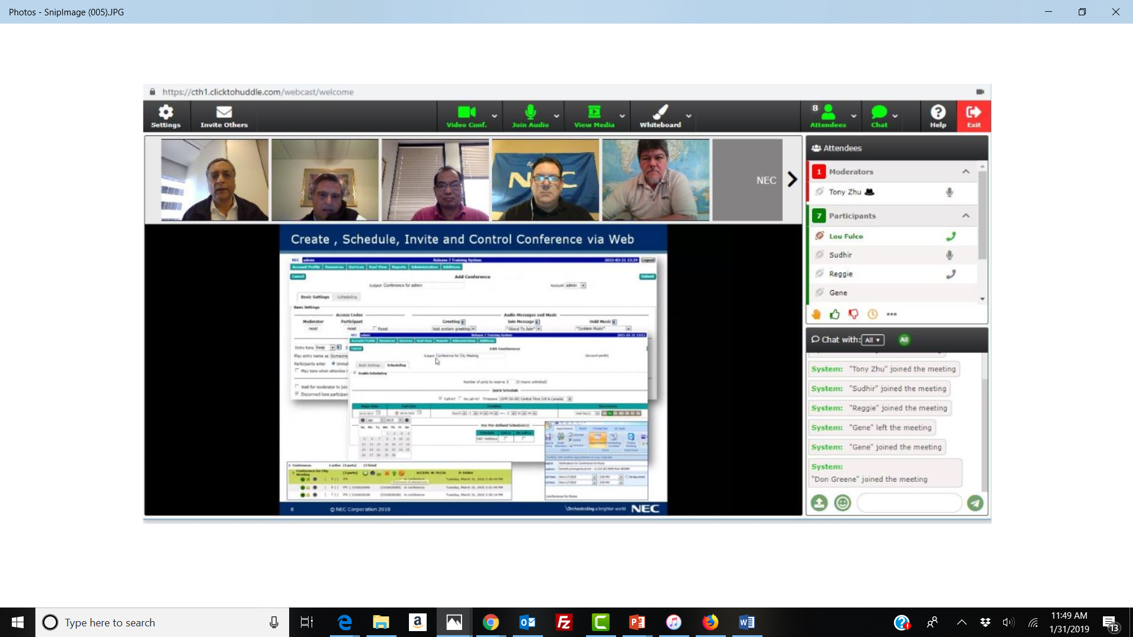
Typical huddle Session – Audio/Video Conference with Screensharing
Click on the View Media icon to restore your view of an ongoing session
Slide 17 of 30 ClicktoHuddle Confidential

Slide 18
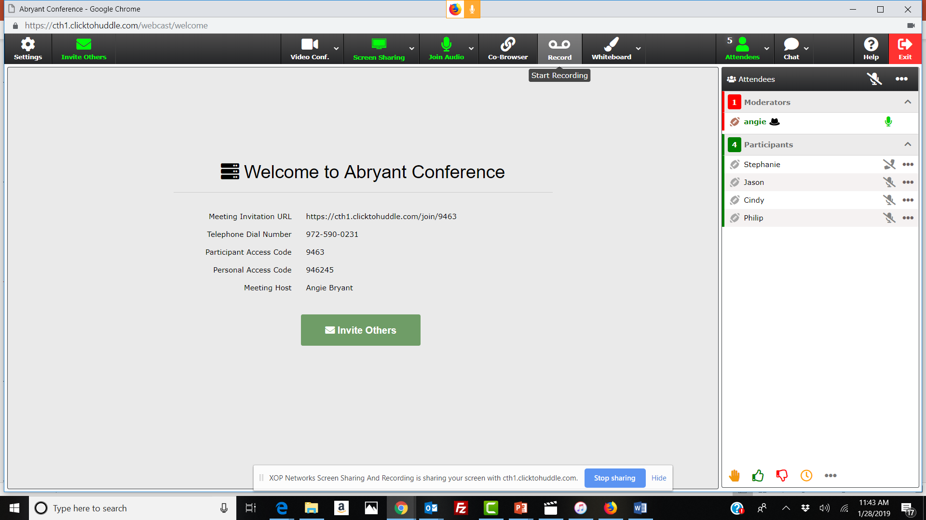
Recording a Huddle Session
To begin recording, select the recording icon
Only a Moderator can record a session
Recording can only be initiated if an audio or video conference is in progress
Participants see their recording icon turn Red if recording is in progress
Slide 18 of 30 ClicktoHuddle Confidential

Slide 19
Invite Attendees from Conference
You can easily invite additional attendees when you are in a conference
Click on the mail icon to invite attendees or click on Invite others from the main page
Slide 19 of 30 ClicktoHuddle Confidential

Slide 20
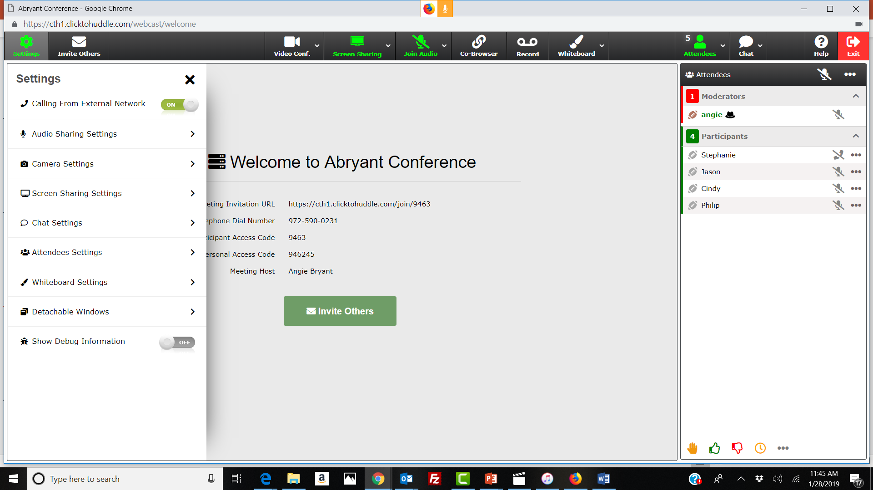
System and Feature Settings
To view/modify settings, click on the settings icon
You can also modify feature settings for individual features by clicking on the associated down arrow
Slide 20 of 30 ClicktoHuddle Confidential

Slide 21
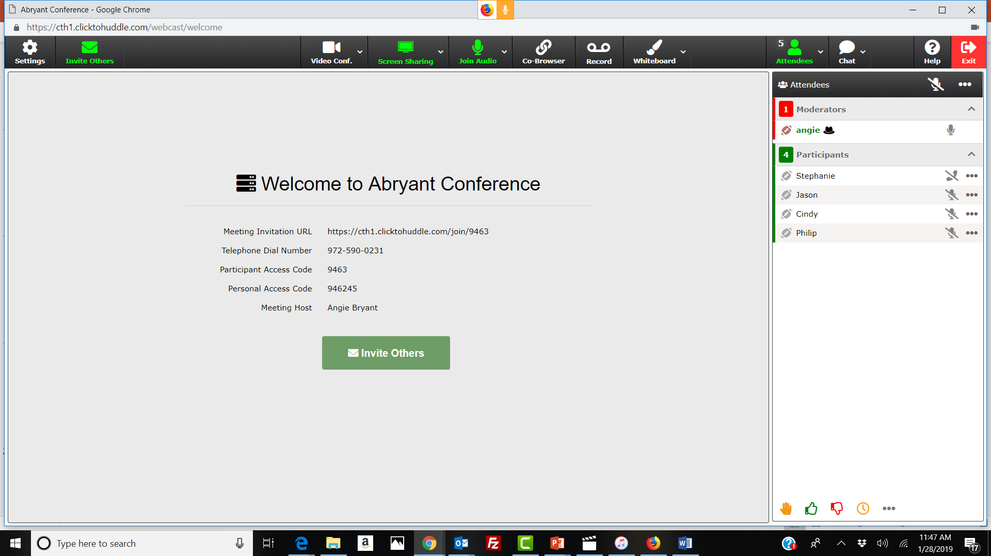
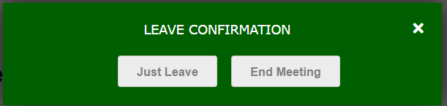
End or Leave Meeting
You can end or leave your meeting pressing the red icon
A pop up will ask you to confirm whether you are leaving or ending the meeting
Slide 21 of 30 ClicktoHuddle Confidential

Slide 22
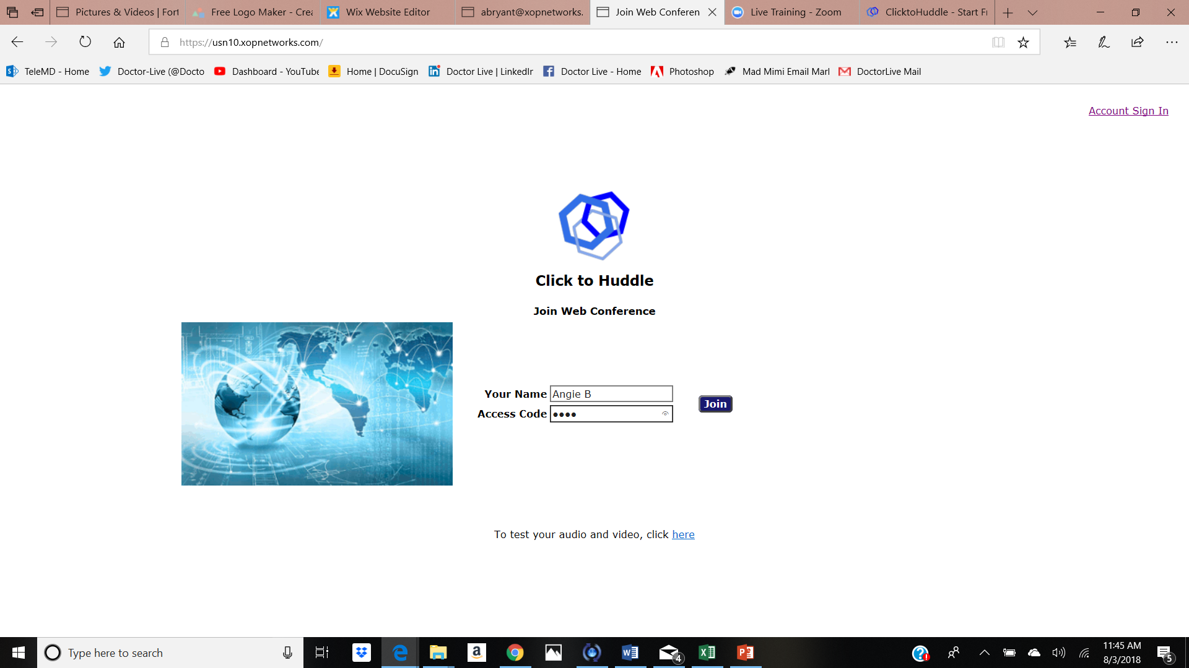
Using Your Recordings
Sign in Here
Your recordings are saved in your Moderator account on the system.
Log into your Account by clicking on the Account Sign In ink (top right hand corner)
Enter your email id and the password you chose when you signed up for the free trial account
Slide 22 of 30 ClicktoHuddle Confidential

Slide 23
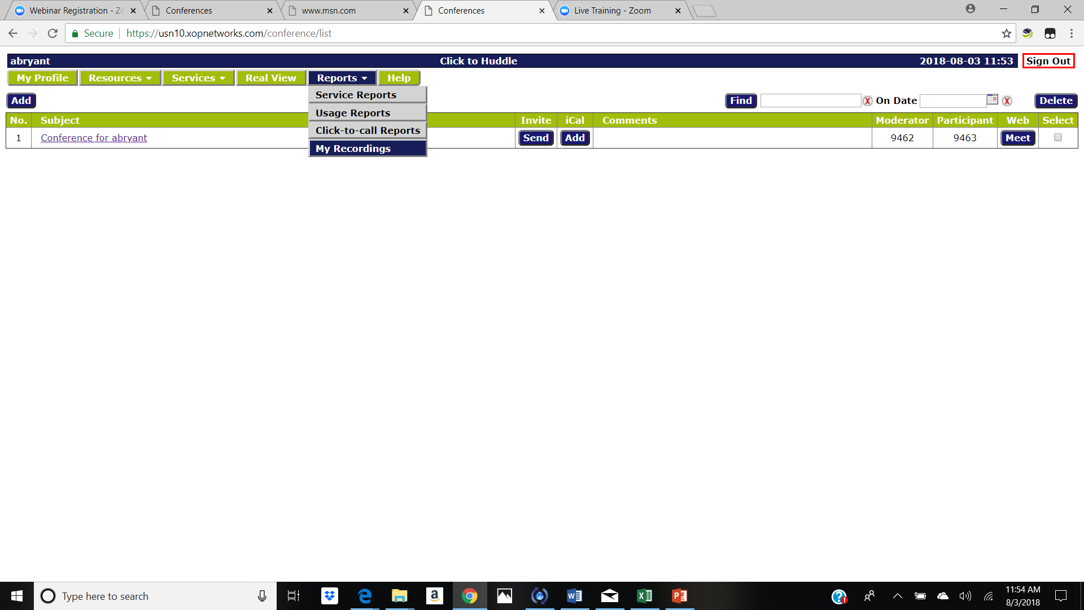
Your Account Settings
Sign in Here
After logging into your Moderator account, familiarize yourself with various settings
Easily invite attendees and initiate huddle by clicking on ‘Meet’
You can view logs and recordings associated with your account usage
Slide 23 of 30 ClicktoHuddle Confidential

Slide 24
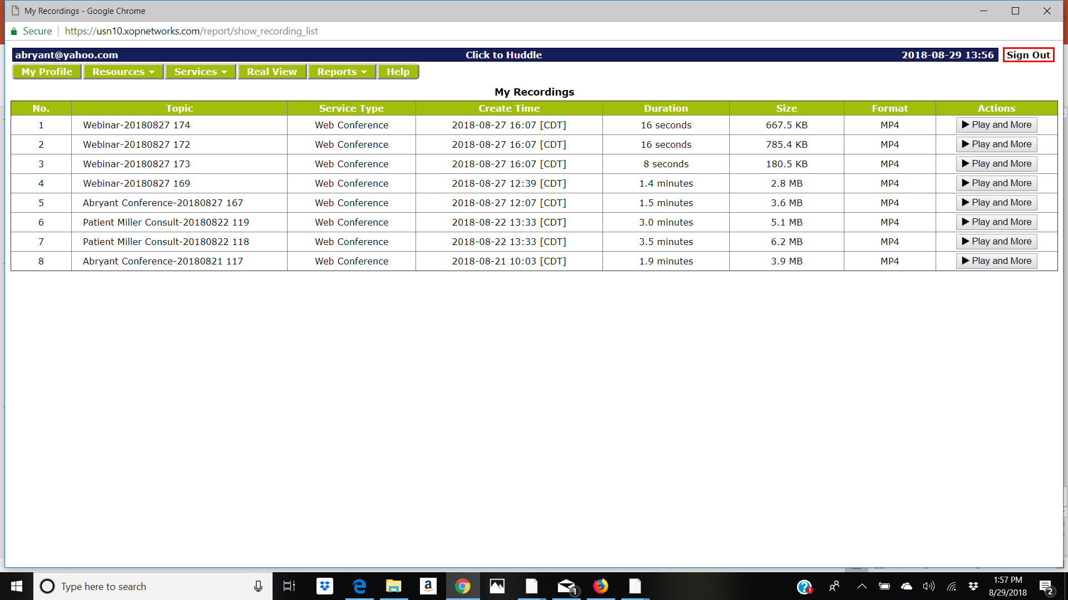
Playback Recordings
Sign in Here
Recordings are stored on the system as MP4 files
Select the recording you would like to play
Slide 24 of 30 ClicktoHuddle Confidential

Slide 25
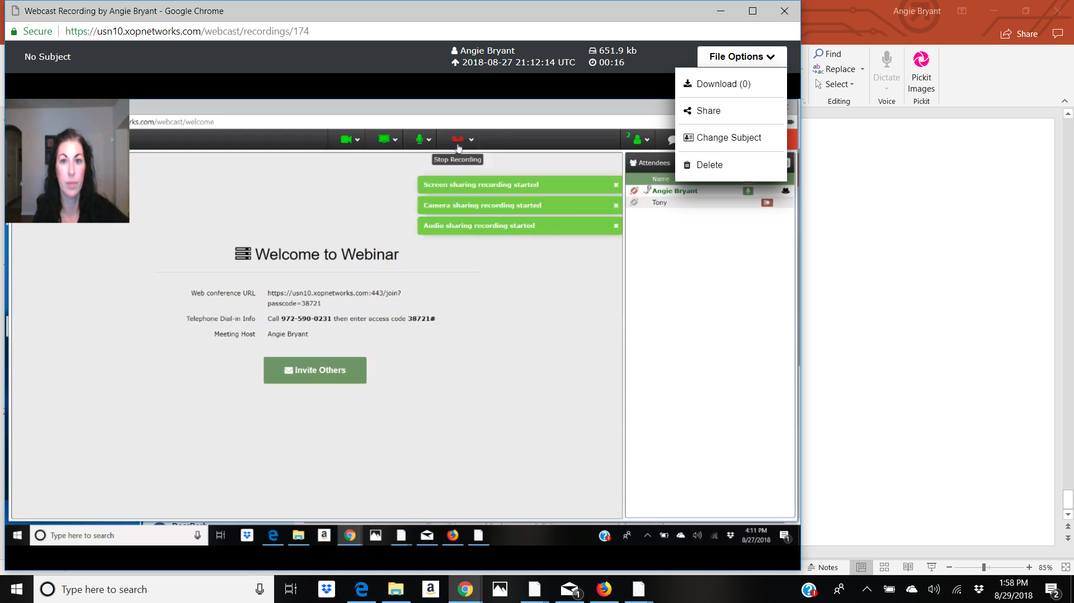
Play Recordings
Sign in Here
Once you select the recording you would like to play
You can download the recording
Share the recording link
Delete recording, please note: this is the only way you can delete your recordings from your account.
Slide 25 of 30 ClicktoHuddle Confidential

Slide 26
Additional Features
Slide 26 of 30 ClicktoHuddle Confidential

Slide 27
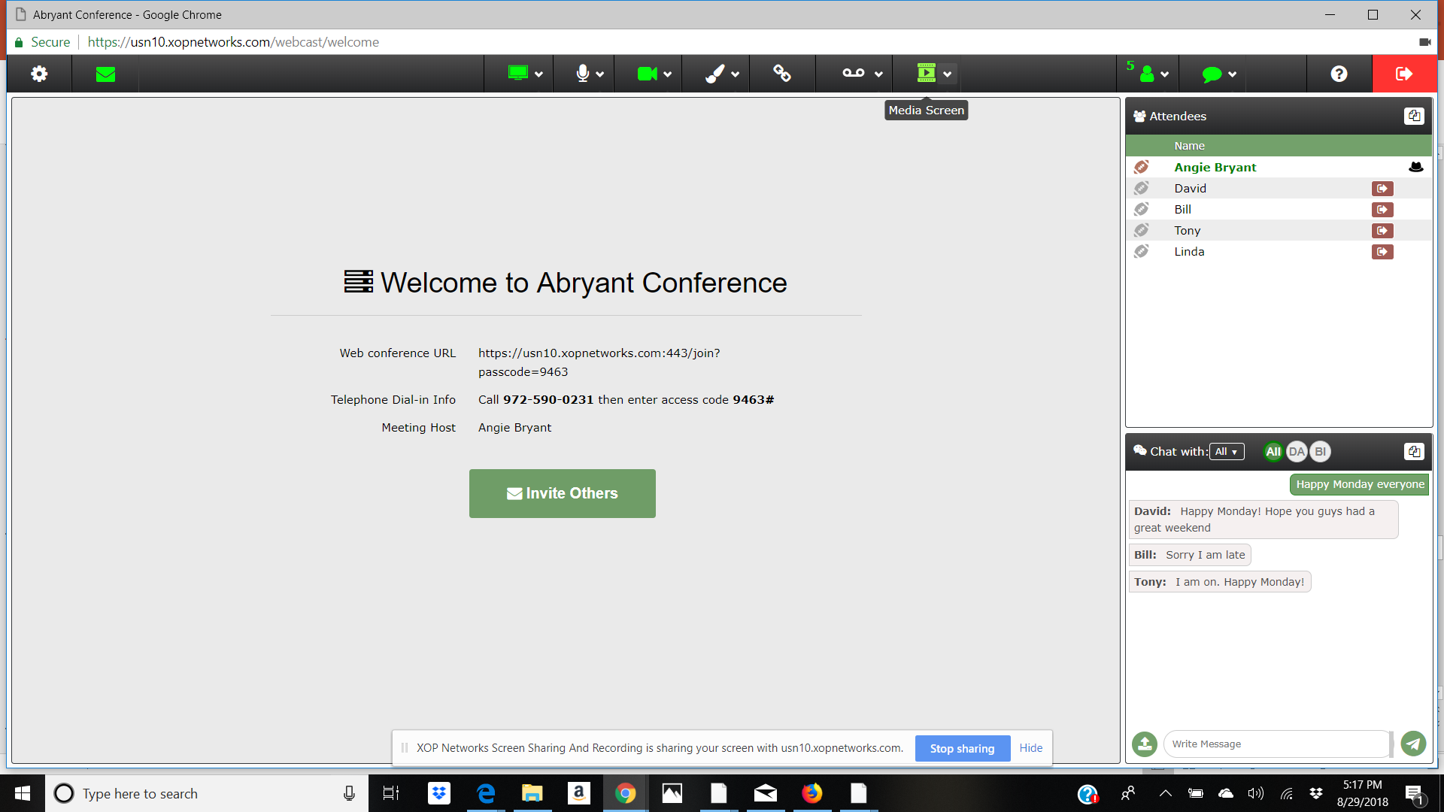
Detach Windows Capability
You can detach the video, attendees & chat panel to move to a second monitor
Click on the detach icon on the specific window
Make sure the ‘Detachable Windows’ setting is enabled on the Settings panel
Slide 27 of 30 ClicktoHuddle Confidential

Slide 28
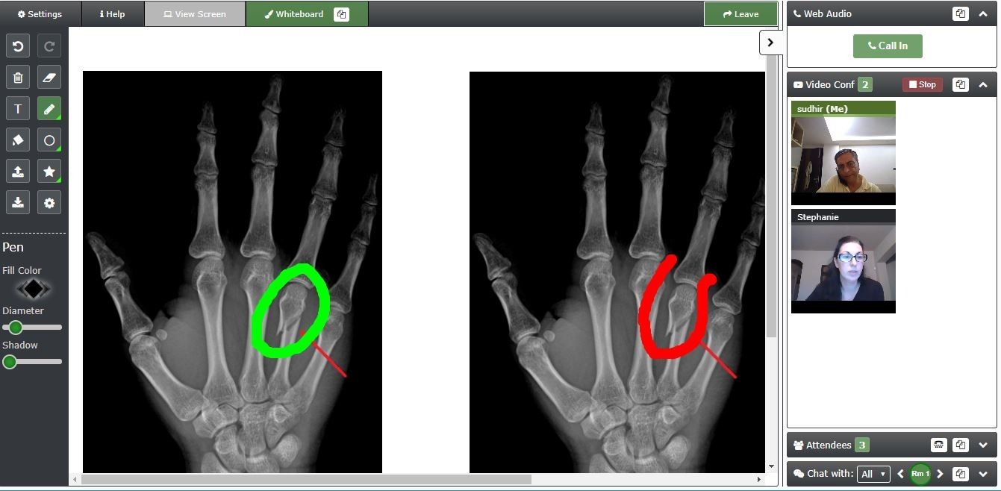
White Board Capability
Design Options
You can use the Whiteboard for multiple collaboration sessions such as telemedicine consults, graphic design or logo creation:
Multiple attendees can collaborate on the Whiteboard at the same time
An image can be uploaded, annotated with text, graphic mark up & ability to save the final image
Any attendee can collaborate during the session without being a moderator
Slide 28 of 30 ClicktoHuddle Confidential

Slide 29
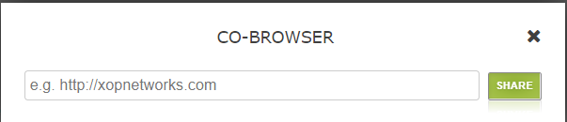
Co-browsing Capability
Co-browsing capability allows a Moderator to share a website with fellow attendees
Type the web site address to share with attendees
Attendees will be alerted indicating that a moderator is wanting to share a website
Slide 29 of 30 ClicktoHuddle Confidential

Slide 30
Removing System Messages from Chat
You can remove system messages & only see chat conversations instead of when people enter and exit
Click on settings
Turn off system messages in Chat Settings
Slide 30 of 30 ClicktoHuddle Confidential

